Slide 1
Find The Break
Meir Marmor, Thomas Dolan,
Charlie Glass, Philippe Gagnon

Slide 2
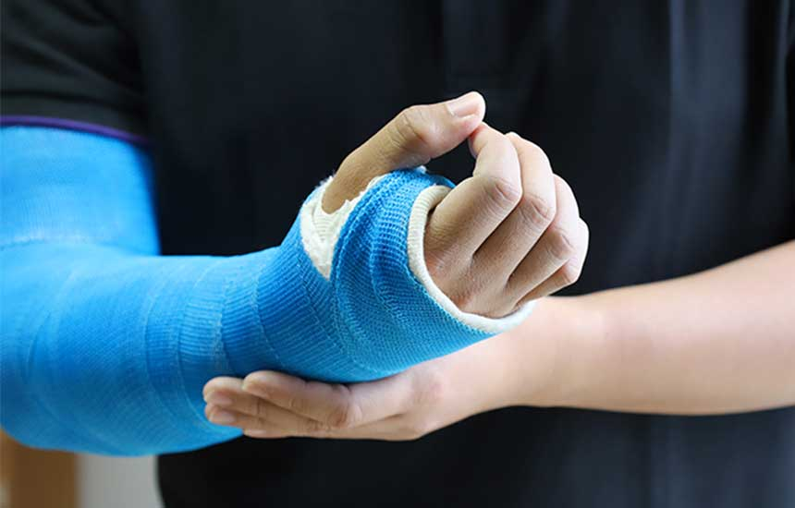
Introduction
206 bones in the body - all prone to break!
Incidence of bone fractures is increasing globally (Cauley 2021)
Accurate diagnosis of fractures is crucial for adequate treatment.
A large proportion of fractures are missed by doctors viewing routine X-rays (Pinto 2018)

Slide 3
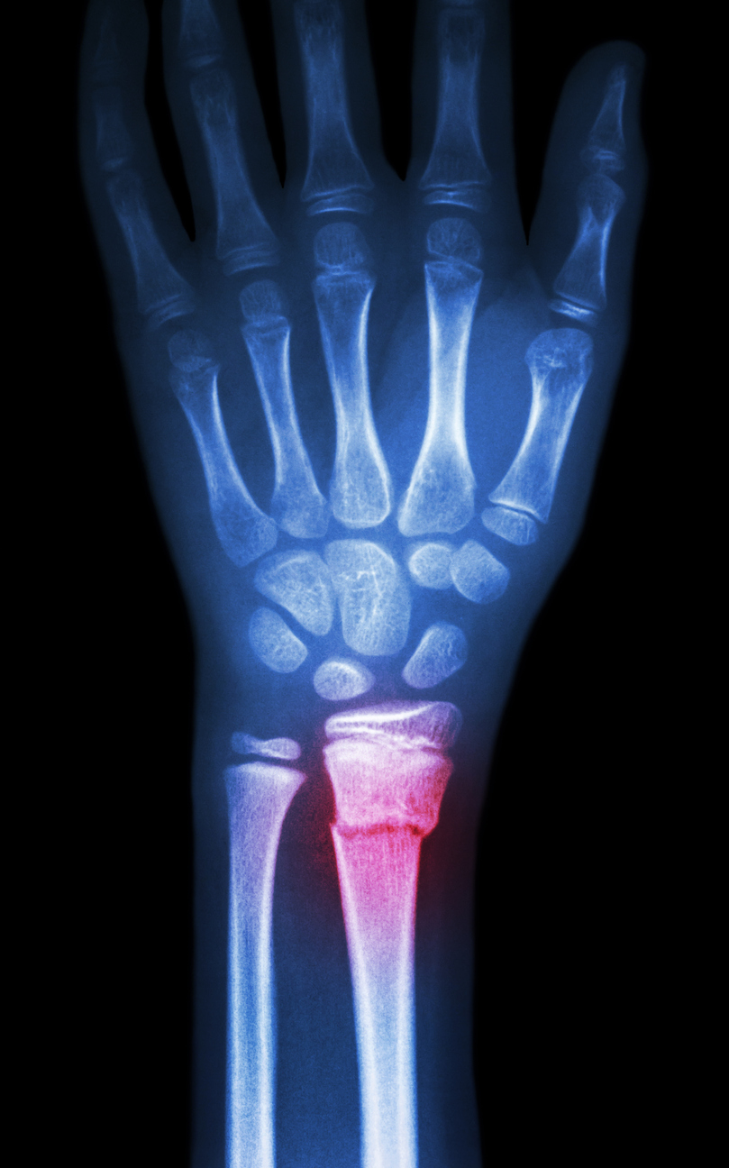
Project Aim
To combine computer vision and machine learning techniques into an algorithm that can accurately detect fractures on plain X-ray films.

Slide 4
METHODS

Slide 5

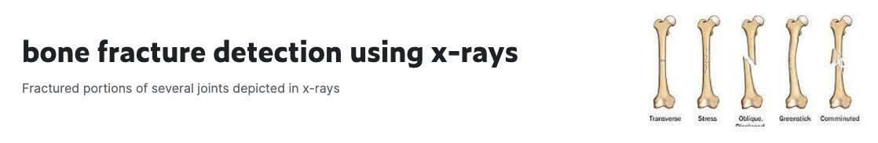
Methods
https://www.kaggle.com/datasets/vuppalaadithyasairam/bone-fracture-detection-using-xrays/data
Fractured: 4,840 images
3920 training
920 validation
Normal: 4,623 images
3713 training
910 validation

Slide 6
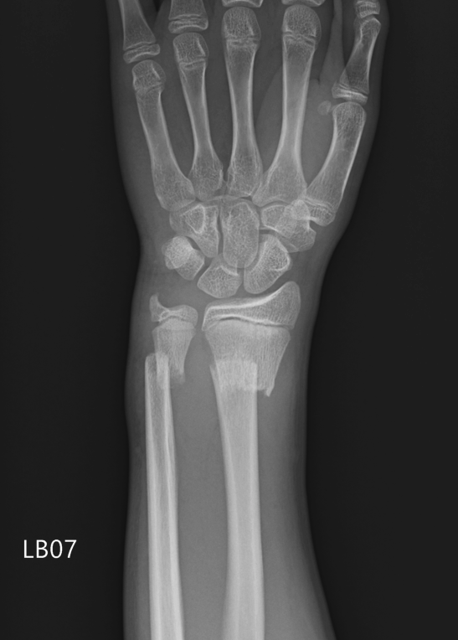
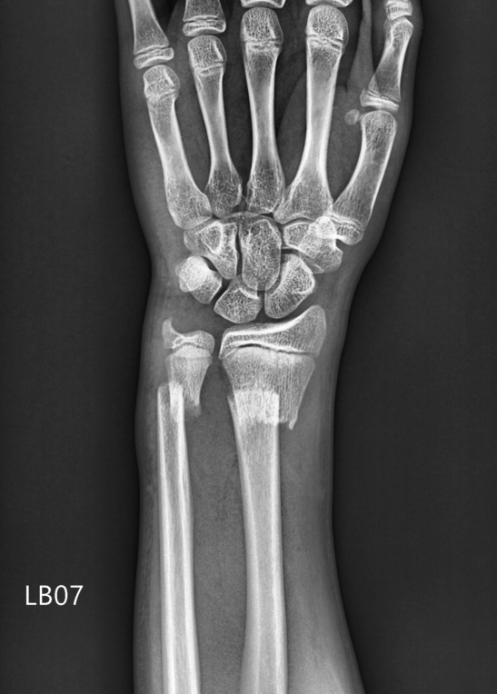
Feature Creation: Pipeline
Original Image
Gaussian Blur
Contrast Enhancement
Notes:
Resized all images to have the same dimensions at 244 x 244
Small gaussian blur to remove salt and pepper noise (Noise at 0 and 255) prevalent in x-ray imagery.
Contrast enhancement to help with canny edge detection
Contrast Limited Adaptive Histogram Equalization (CLAHE)
Applies Histogram equalixzation locally to different sections of the image (tiles) preventing the overamplification of noise

Slide 7
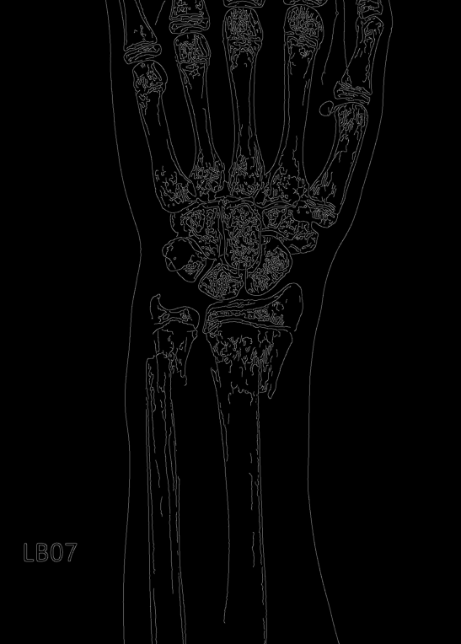
Feature Creation: Pipeline
Original Image
Canny Edges

Slide 8
Feature Creation: GLCM & LBP
Gray Level Co-Occurrence Matrix (GLCM)
“A statistical method of examining texture that considers the spatial relationship of pixels”^{[1]}
Created features at multiple distances and angles as supported by the literature^{[3]}
Extracted 4 features: Contrast, Correlation, Energy, Dissimilarity, and Homogeneity across these angles and distances.
140 features extracted per image
Local Binary Patterns (LBP)
“looks at points surrounding a central point and tests whether the surrounding points are greater than or less than the central point (i.e. gives a binary result)”^{[2]}
Creates features that represent the distribution of local features
34 features extracted per image
Notes:
Two different methods of texture based feature extraction GLCM and LBP
All features normalized for use in binary classification

Slide 9
RESULTS

Slide 10
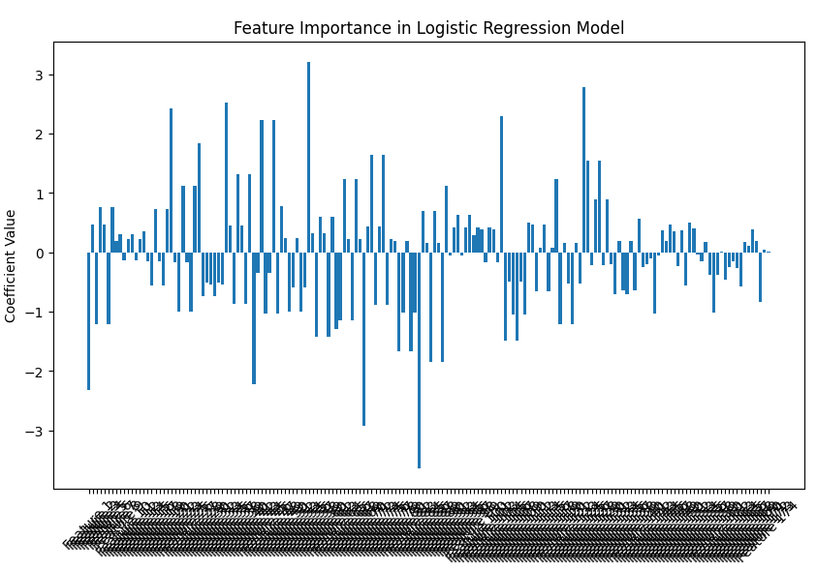
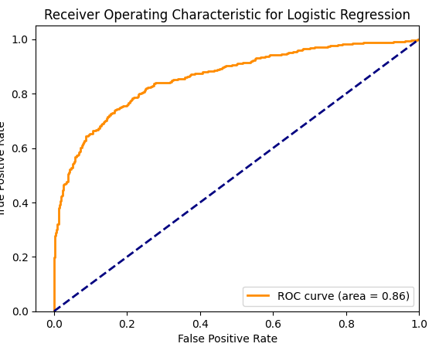
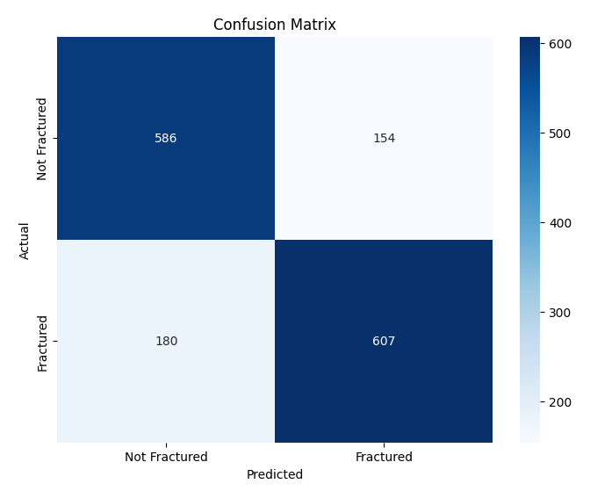
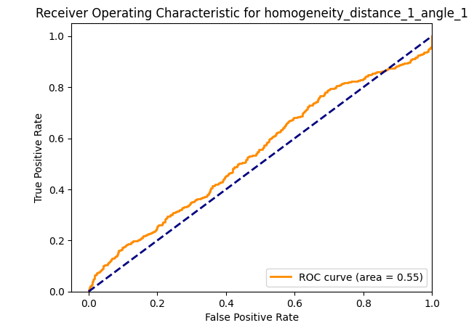
Logistic Regression Model

Slide 11
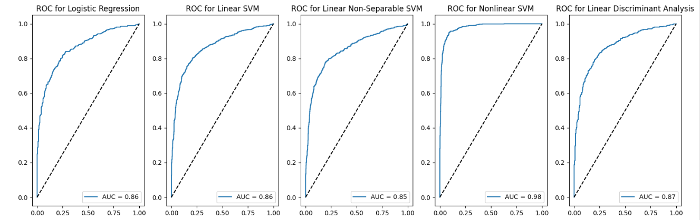
Comparison of Classifiers - Training ROC curves (GLCM+LBP)

Slide 12
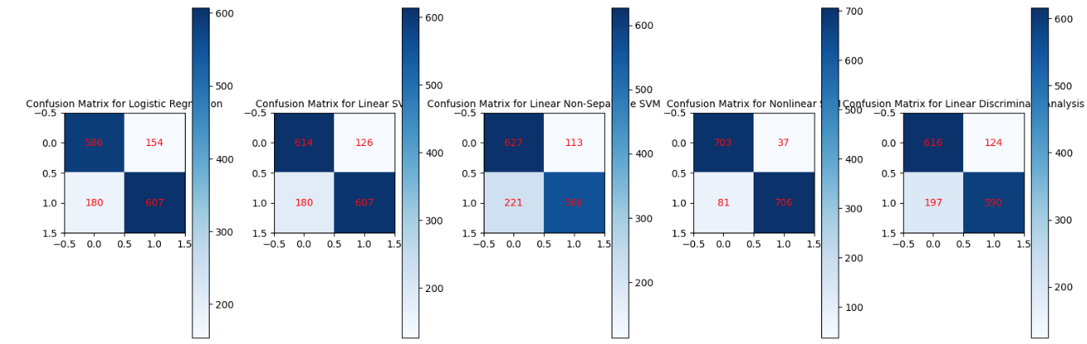
Comparison of Classifiers - Training Confusion Matrices (GLCM+LBP)

Slide 13
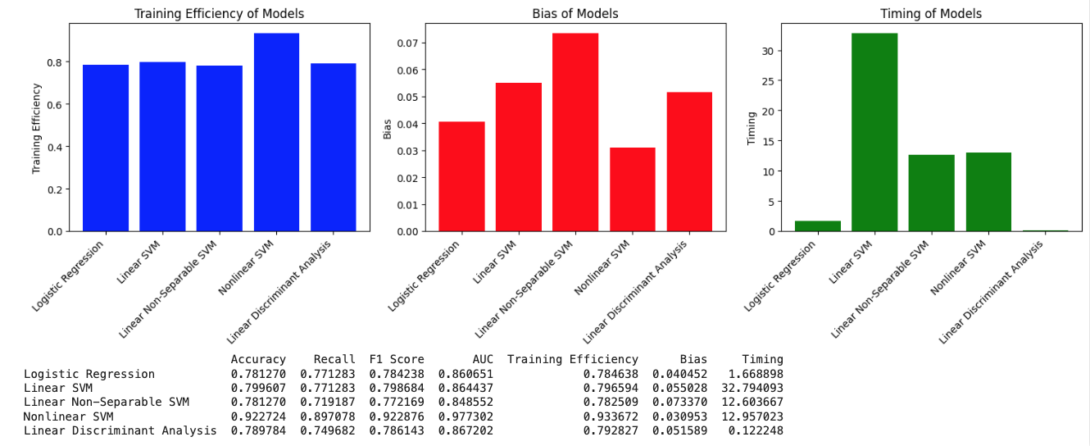
Comparison of Classifiers - Training Efficiency (GLCM+LBP)

Slide 14
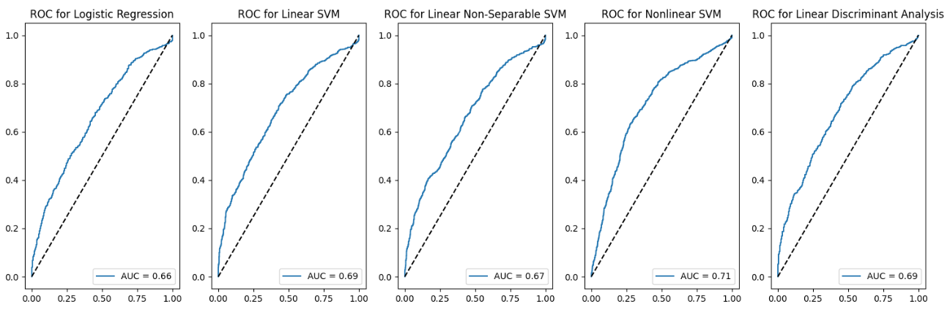
Comparison of Classifiers - Test ROC curves (GLCM+LBP)

Slide 15
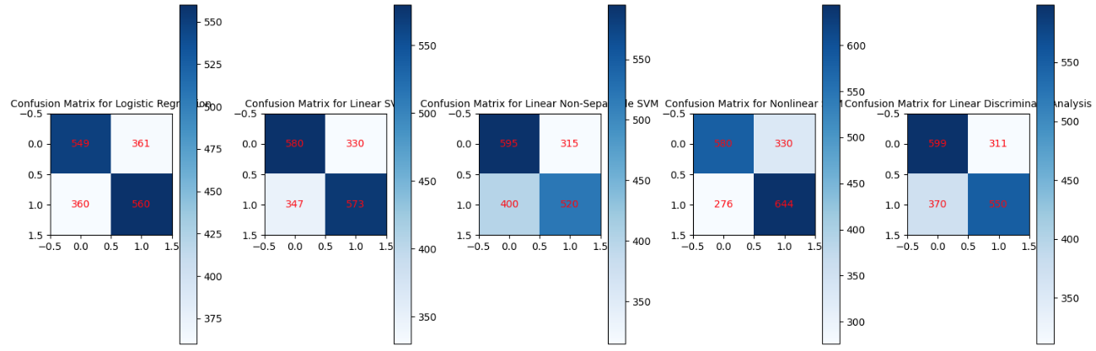
Comparison of Classifiers - Test Confusion Matrices (GLCM+LBP)

Slide 16
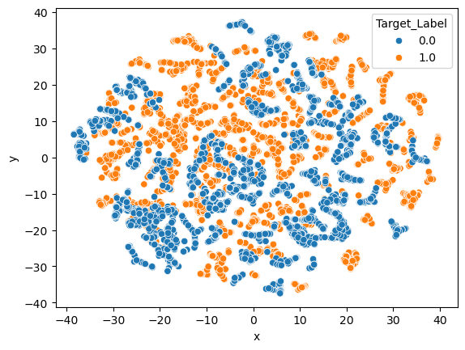
TSNE
Notes:
TSNE
-When looking at the TSNE to see how separable our data is using non linear functions we can see why the Non-linear SVM worked as well as it did
- You can see a good amount of separation between the fractures in orange and the Normal X-rays in blue
- Though in some clusters you can still see they are not able to be very well separated. Possibly due to smaller fractures or not as many x-rays for the specific area wrists vs legs vs arms.

Slide 17
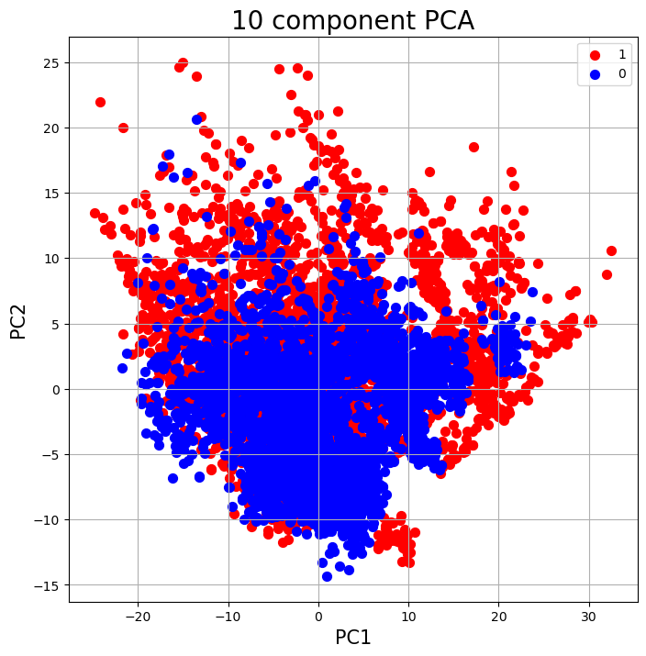
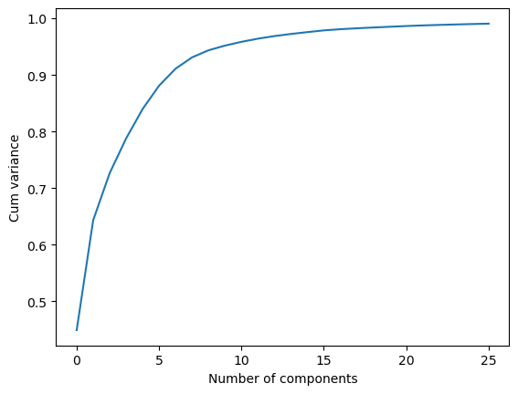
PCA
Notes:
PCA
When using PCA to visualize the data you can still see some of the story
When looking at the plot of the two principal components we still see a good deal of overlap in them in these components however on the whole you can see that the fractures are much more widely distributed.
When using PCA we were able to scale our data down from 174 features to 26 features while capturing 99 percent of the variance
This reduced the training times of our models by about 10 percent and led to no significant tradeoffs when looking at the ROC curves of our validation data.

Slide 18
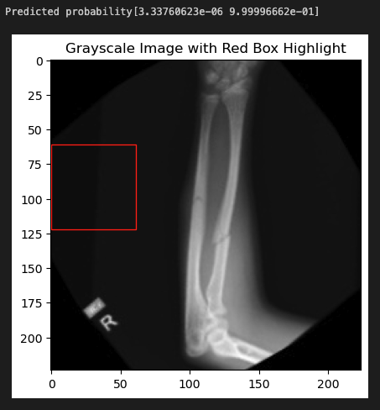
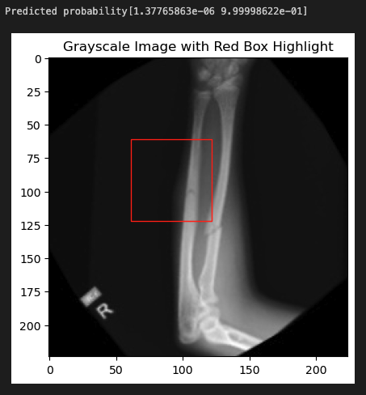
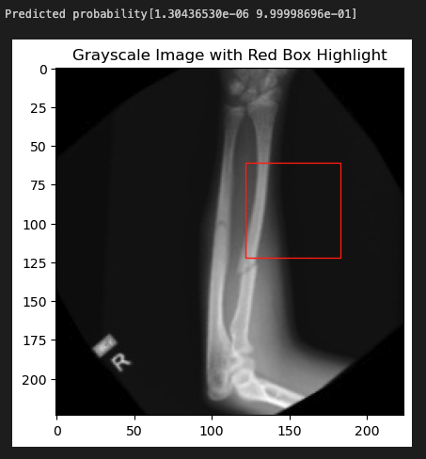
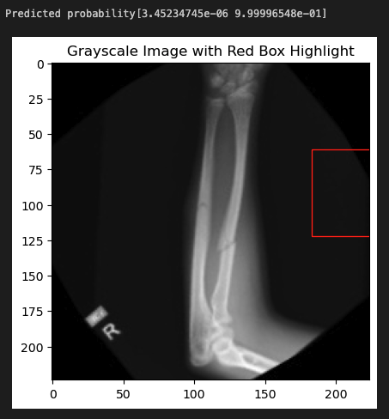
Bounding Box Prediction
Notes:
Bounding Box Prediction
Using our best model the Non-linear SVM we tried to get predictions on a sliding window that would create bounding boxes.
Our hope was that we would be able to process the sliding window using the same feature extraction methods and get a prediction weather there was a fracture the window and we could display a bounding box of the location of the fracture.
Unfortunately it could not. And it would consistently predict that there was a fracture in the image, even in empty space. Suggesting we would need to either build another model for this task or find features that we could extract with tolerance to scale variations

Slide 19
CNN & ResNet
Model | Layers | Train Accuracy | Validation Accuracy
CNN w/ ResNet50 Feature | Conv2D layer of 12 units, 3x3 kernels MaxPooling2D layer, 3x3 Dropout layer, rate 0.7 | 97% | 48%, only predicted not fractured
Logistic Regression w/ Dropout & LBP Normalized Features | Dropout layer, rate 0.7 | 68% | 69%
CNN w/ LBP Normalized Features & ResNet50 Feature | Hidden layer of 16 units (LBP Features) Conv2D layer of 16 units, 3x3 kernels (ResNet50 features) MaxPooling2D layer, 3x3 (ResNet50 features) Dropout layer, rate 0.7 (LBP features) Dropout layer, rate 0.95 (ResNet50 features) | 80% | 79%
ResNet50 CNN | No additional layers | 99% | 83%

Slide 20
DISCUSSION

Slide 21
Main Findings
Best model was Non-linear SVM - AUC 0.97
Generalization to test data was fair - AUC 0.71
PCA reduced features to 26 while maintaining ROC performance and reducing training time
ResNet50 CNN performed well on validation set but did not outperform Non-linear SVM
The model did not scale down well to create a bounding box for locating the fracture

Slide 22
Limitations
Test-Train split was done randomly - may have caused imbalances in the data sets
A majority of the images were rotation views of the same fracture
Normal X-rays had more rotation views than fracture X-rays
Images may have undergone unknown pre-processing steps

Slide 23
Future Directions
Add more independent images and reduce amount of augmentation
Relabeling of the dataset on smaller image sections may help bounding box algorithm development.

Slide 24
Citations
https://www.mathworks.com/help/images/texture-analysis-using-the-gray-level-co-occurrence-matrix-glcm.html
https://scikit-image.org/docs/stable/auto_examples/features_detection/plot_local_binary_pattern.html
https://www.sciencedirect.com/science/article/pii/S2665917423000594
Cauley JA. The global burden of fractures. Lancet Healthy Longev. 2021 Sep;2(9):e535-e536.
Thomas JL. WHAT INFLUENCE HAS THE USE OF X RAYS HAD UPON TREATMENT OF FRACTURES AND DISLOCATIONS? Br Med J. 1906 May 5;1(2366):1034-7.
Kahn CE Jr, Carrino JA, Flynn MJ, Peck DJ, Horii SC. DICOM and radiology: past, present, and future. J Am Coll Radiol. 2007 Sep;4(9):652-7.
Kalmet PHS, Sanduleanu S, Primakov S, Wu G, Jochems A, Refaee T, Ibrahim A, Hulst LV, Lambin P, Poeze M. Deep learning in fracture detection: a narrative review. Acta Orthop. 2020 Apr;91(2):215-220.
Pinto A, Berritto D, Russo A, Riccitiello F, Caruso M, Belfiore MP, Papapietro VR, Carotti M, Pinto F, Giovagnoni A, Romano L, Grassi R. Traumatic fractures in adults: missed diagnosis on plain radiographs in the Emergency Department. Acta Biomed. 2018 Jan 19;89(1-S):111-123.

